Slide 1
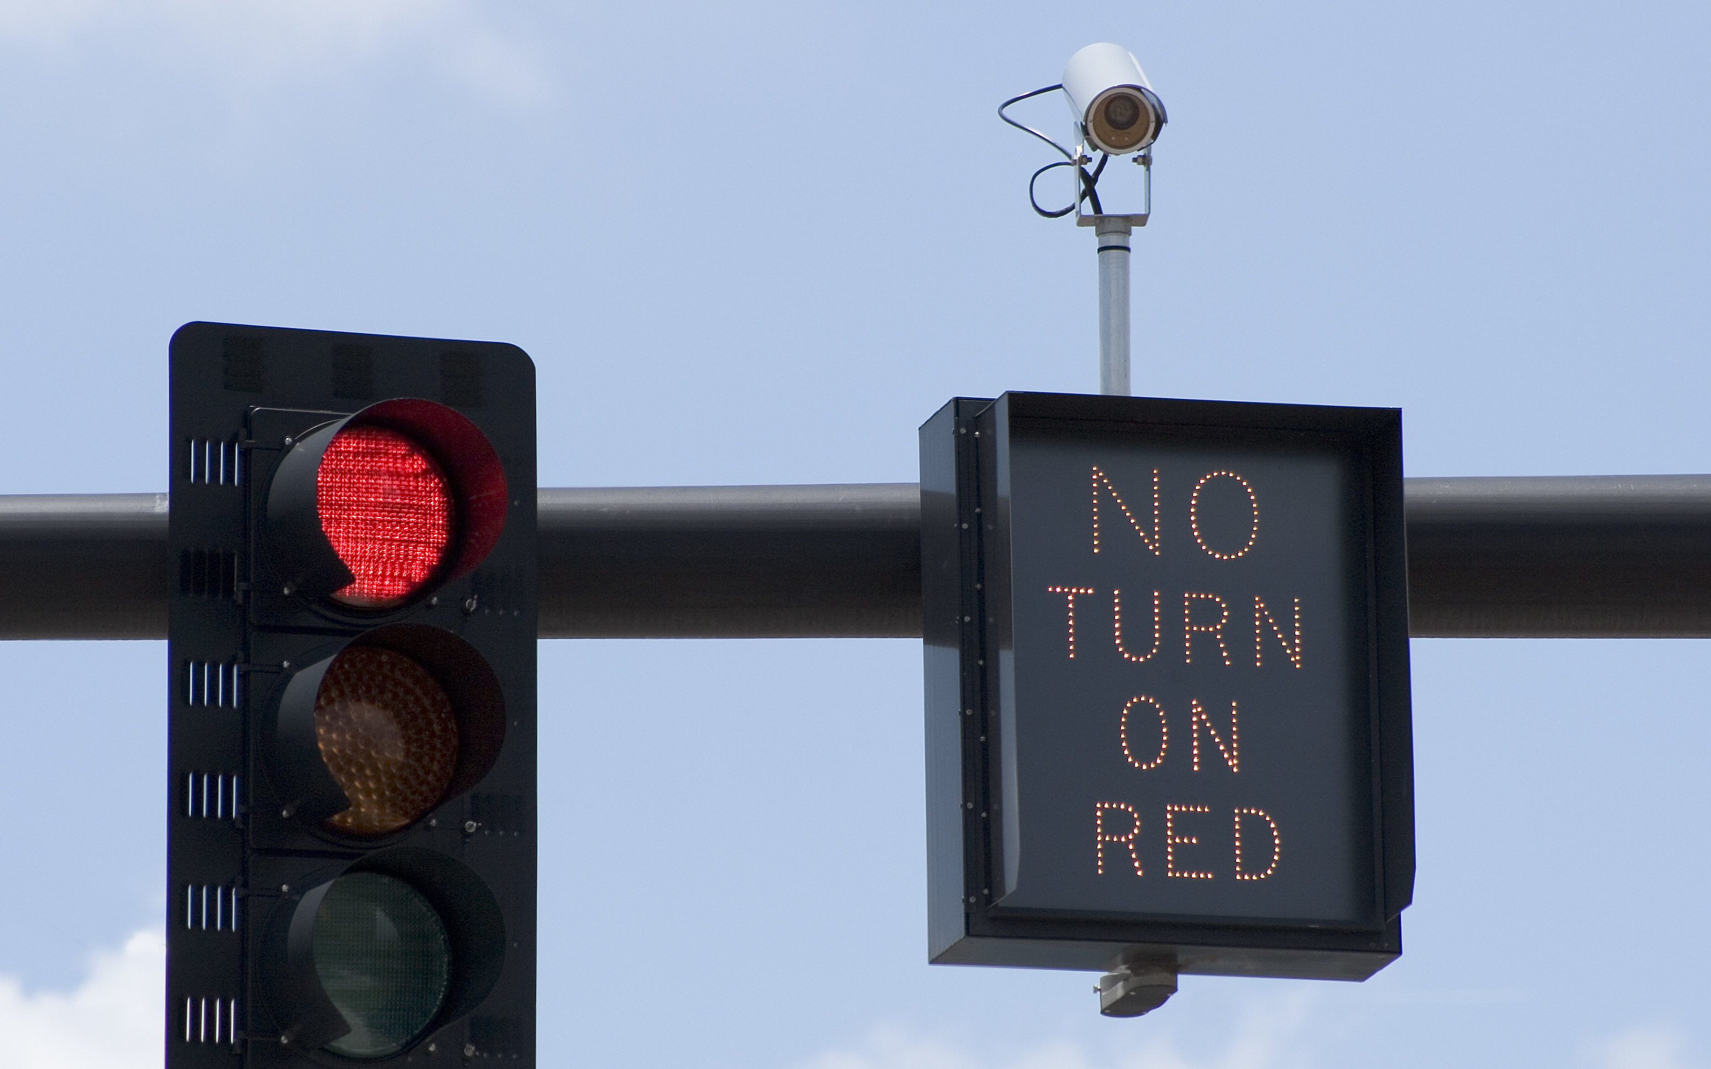
Analyzing Chicago Red Light Camera Violations
By: Neel Kumtakar
3/20/2020

Slide 2
Introduction: What are we studying
Red Light Camera Violation – When a motorist runs through a red light and a camera captures the culprit in the act
Red Light Violations do cause problems for the motorist, i.e. having to pay a fine, but also the police. A Red-light violation might happen but then an accident occurs an hour or minutes later. An accident causes police time to investigate and money.
Causes for Red Light Violation:
Late for work or some event
Trying to “Beat” the light, due to short distance
No police around or pedestrians

Slide 3
Introduction: What this project is about
Goal: To identify which regions or places in Chicago where the Red Lights captures the most violations.
By identifying the regions, police can allocate resources (more warning signs and police cars standby) in the region to reduce the number of violations.
This will reduce the amount of money people will have to pay out of their pocket for the citations from committing the violations
The number of motorist accidents from running a red light should reduce, which will save the government and the police department time and $ to investigate.

Slide 4
Describing the Dataset
Source: Kaggle
Data has been gathered by the City of Chicago Red Light program
Each row corresponds to a Red-Light Camera and the number of violations captured from the camera on a day
Violations occurred from July 1, 2014 to Sept 7, 2017
Data Source: https://www.kaggle.com/chicagopolice/chicago-red-light-violations/data

Slide 5
Describing the Dataset: The Variables
Intersection: Intersection of the location of the red-light enforcement camera(s).
Camera ID: A unique ID for each physical camera at an intersection
Address: The address of the physical camera (CAMERA ID)
Violation Date: The date of when the violations occurred.
Violations: Number of violations for each camera on a day.
X Coordinate: The X Coordinate, of the location of the camera.
Y Coordinate: The Y Coordinate, of the location of the camera.
Latitude: The latitude of the physical location of the camera(s)
Longitude: The longitude of the physical location of the camera(s)
Location: The coordinates of the camera(s) based on the LATITUDE and LONGITUDE columns.
Zipcode- Zip code of the Intersection ( Added by Neel, geolocated on Intersection)

Slide 6
Descriptive Analysis : Missing Values
Dataset Dimensions: 310579 rows x 11 columns
Variables | Missing %
Intersection | 0%
Camera ID | 0.1%
Address | 0%
Violation Date | 0%
Violations | 0%
X Coordinate | 6%
Y Coordinate | 6%
Latitude | 6%
Longitude | 6%
Location | 6%
Zipcode | 0%

Slide 7
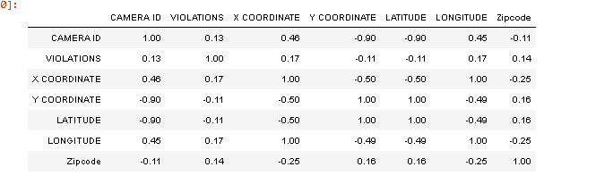
Descriptive Analysis: Correlations
Mostly neural correlations, however, Camera ID seems to be extremely negatively correlated with Y coordinate and Lat.
Latitude and Y coordinates are positively correlated
Longitude and X coordinate are positively correlated
Latitude and Longitude are negatively correlated

Slide 8
Descriptive Analysis: Modes, and Variances
CALIFORNIA AND DIVERSEY
Most frequent Intersection: California and Diversey
Most frequent Address: 600 W Roosevelt Road
Average Number of Violations per day 6
Variance of Violations: 52
Standard Dev of Violations is 7

Slide 9
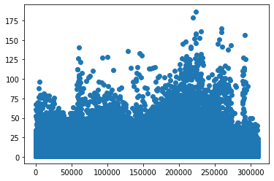
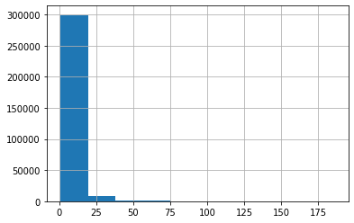
Plots and Visualizations
Scatterplot of Violations by obs #
A camera can capture 175 violations on one day!
Histogram of Violations:
Most of the data’s observations have between 0-25 violations

Slide 10
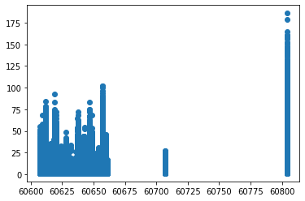
Plots and Visualizations
Scatterplot of Zipcode by Violations
3 group of Violations.
Zipcodes 60600-60650 have violation range [0,100]
Zipcode 60705 have violation range of [0,25]
Zipcode 60805 have violation range of [0,180]

Slide 11


Data Preprocessing: Removing variables
Remove Intersect and Address variables due to extremely high cardinality
In addition, remove Latitude, Longitude, X coordinate and Y coordinate, and locations variables due to being just identifiers
Remove Camera ID because it’s an identifier

Slide 12
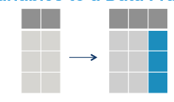
Data Preprocessing: Adding variables
Add “Cost” variable for each violation to model the amount of money each camera receives for a violation
$100 for a red light camera violation
Add “Red Flag” binary variable to highlight observations where a value of 1 signifies the number of violations is greater than the mean number of violations in the dataset
This will be the “Target” variable

Slide 13
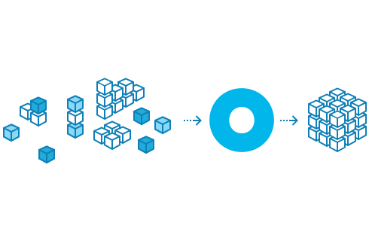
Data Preprocessing: Transforming variables
Split the Year variable into 4 dummy variables
There are 45 unique Zip codes.
Divide the Zipcode var into 5 “regions” dummy variables, with 9 zip codes in each region, i.e. Region 1, Region 2, … Region 5
There are 12 months
Divide the month variable into 4 dummy Season variables, “Winter”, “Spring”, “summer”, and “Fall”, by month.
Split the Year variable into 4 dummy variables as there are 4 years in the set.

Slide 14
Fitting Models
Decision Tree
Great for classification
Can reveal classification rules/ properties of the target class that may not be detected from just a glance
Easy to explain
Naïve Bayes
Probabilistic model, and it has “naïve” property, meaning features are independent of each other with respect to the Target Variable
Can give probabilities for each obs with respect to what the obs should belong to.
Classify by probability.

Slide 15
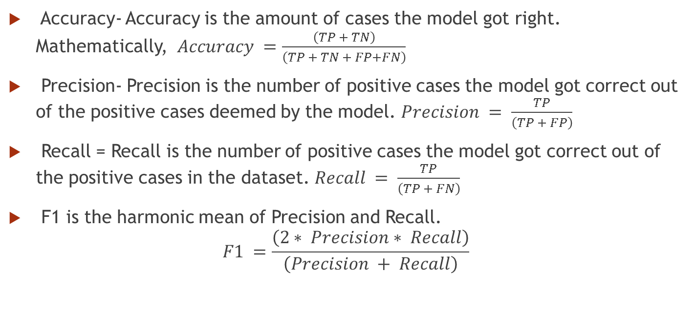
Performance Metrics Used
Accuracy- Accuracy is the amount of cases the model got right. Mathematically, $Accuracy =\frac{\left(TP + TN\right)}{\left(TP + TN + FP+FN\right)}$
Precision- Precision is the number of positive cases the model got correct out of the positive cases deemed by the model. $Precision = \frac{TP}{\left(TP + FP\right)}$
Recall = Recall is the number of positive cases the model got correct out of the positive cases in the dataset. $Recall = \frac{TP}{\left(TP + FN\right)}$
F1 is the harmonic mean of Precision and Recall.
$$F1 =\frac{\left(2∗ Precision∗ Recall\right)}{\left(Precision + Recall\right)}$$

Slide 16
Warning!
When we compare models, we will see that some models with certain parameters tend to overfit.
A clear sign of overfitting is when the precision, accuracy, F1, and Recall are all 100%.
It’s less likely that a model legitimately exists with those kind of metrics.

Slide 17
Decision Tree Parameters
Parameters chosen:
Splitter – “Random”, or “Best” – Decides when to split, “best” lets the machine choose the best split, while “random” lets the machine choose the best “random” split
Max_Depth = Maximum depth of the tree. Can decide how long the tree. Too long of a tree can cause overfitting.
Max_Features = How many features at the max used for splitting. This can affect how the tree is split.

Slide 18
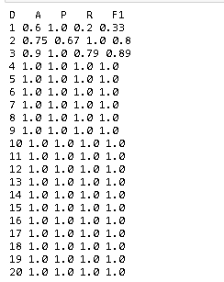
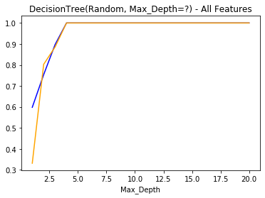
DecisionTree(Splitter= Random, Max Depth = ?)

Slide 19
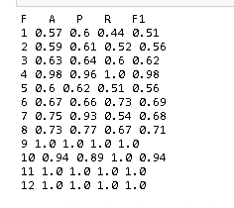
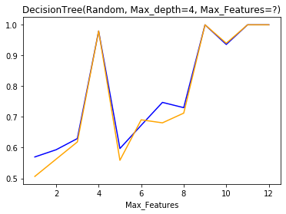
DecisionTree(Splitter= Random, Max Depth = 4, Max_Features-?)

Slide 20
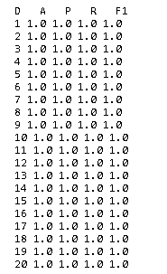
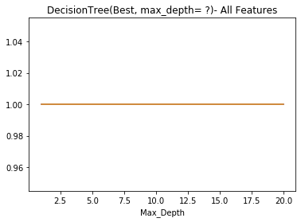
DecisionTree(Splitter= Best, Max Depth = ?)

Slide 21
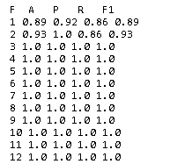
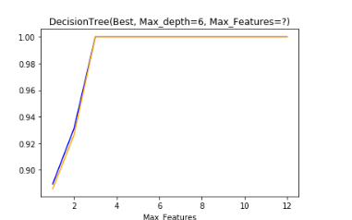
DecisionTree(Splitter= Best, Max Depth = 6, Max_Features-?)

Slide 22
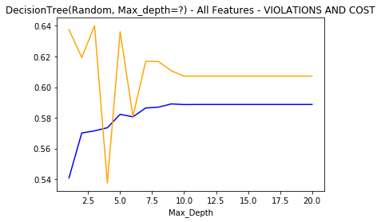
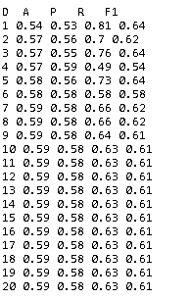
DecisionTree(“Random", "Max_Depth=?") - All Features - VIOLATIONS AND COST

Slide 23
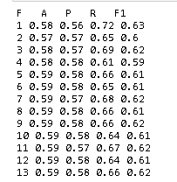
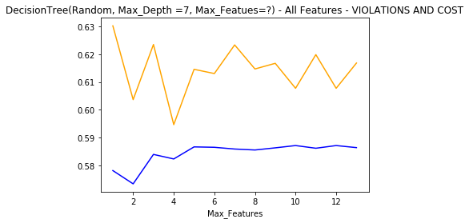
DecisionTree(“Random", 'Max_Depth =7", "Max_Features=?') - All Features - VIOLATIONS AND COST

Slide 24
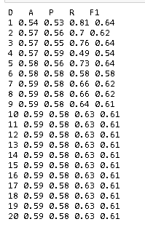
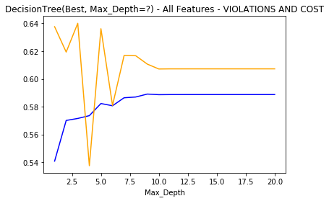
DecisionTree("Best", "Max_Depth=?") - All Features - VIOLATIONS AND COST

Slide 25
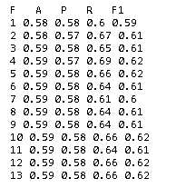
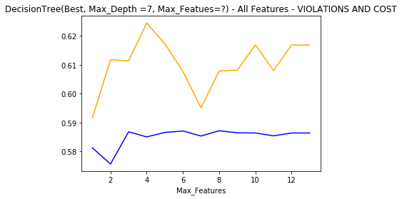
DecisionTree("Best", 'Max_Depth =7", "Max_Features=?') - All Features - VIOLATIONS AND COST

Slide 26
Why did the performances drop when we decided to cut out Violations and Cost?
The Target Variable, “Red Flag” relies on the Violations variable, so when it was cut out, the model couldn’t make reliable predictions without it
Cost was also responsible for the high accuracy of the Decision Tree models since it was related to Violations and indirectly “Red Flag”
Target and Cost make up 40% the model’s accuracy power. The rest of the variables seem to constitute 60%.

Slide 27
Decision Tree Model Comparison:
Model | Splitter | Max_Depth | Max_features | Features | Accuracy | Precision | Recall | F1
1 | Random | 3 | N/A | All | 0.9 | 1 | 0.79 | 0.89
2 | Best | 1 | N/A | All | 1 | 1 | 1 | 1
3 | Random | 4 | 10 | All | 0.94 | 0.89 | 1 | 0.94
4 | Best | 6 | 2 | All | 0.93 | 1 | 0.86 | 0.93
5 | Random | 7 | N/A | All-V/C | 0.59 | 0.58 | 0.66 | 0.62
6 | Best | 7 | N/A | All-V/C | 0.59 | 0.58 | 0.66 | 0.62
7 | Random | 7 | 7 | All-V/C | 0.59 | 0.57 | 0.68 | 0.62
8 | Best | 7 | 5 | All-V.C | 0.59 | 0.58 | 0.66 | 0.62
Model 2 excluded due to high probability of overfitting. Model 3 is the best Decision Tree model due to High Accuracy and F1 measures.

Slide 28
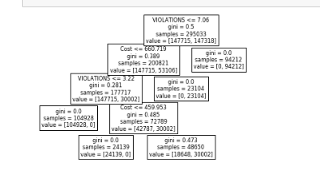
Interpreting Decision Tree
Any Red Light case classified as a “red flag” has these qualities
Violations > 7.06
Violations ≤ 7.06 AND Cost > $ 660.72

Slide 29
Interpreting Decision Tree: DT Insights
Region | % of Red Flag Cases by Region
1 | 20%
2 | 28%
3 | 17%
4 | 21%
5 | 14%
While the DT doesn’t tell us anything about the region (zipcodes), we can use the rules and some data manipulation to figure it out.
Based on the DT, Region 2 and 4 have the most Red Flag cases.

Slide 30
Naïve Bayes (Gaussian) Parameters
Parameters chosen:
Var_Smoothing-Portion of the largest variance of all features that is added to variances for calculation stability.
Can change the performance metrics, so we should play with this parameter
Also the only parameter since “priors” doesn’t seem to work.

Slide 31
Comparing Models- Naïve Bayes
Model | Var_Smoothing Constant | Accuracy | Precision | Recall | F1
1 | 0.01 | 1 | 1 | 1 | 1
2 | 0.02 | 0.90 | 1 | 0.79 | 0.89
3 | 0.1 | 0.82 | 1 | 0.64 | 0.78
4 | 0.5 | 0.71 | 1 | 0.43 | 0.60
5 | 0.9 | 0.68 | 1 | 0.36 | 0.53
6 | 5 | 0.63 | 0.41 | 1 | 0.26
As the constant value increases, the Metrics start to perform poorly. However, at 0.02, we have the optimal values of accuracy, Precision, Recall and F1 scores. A constant value of 0.01 causes the model to overfit which is something we don’t want.

Slide 32
Comparing Models- Naïve Bayes, (minus Violation and Cost Variables)
Model | Var_Smoothing Constant | Accuracy | Precision | Recall | F1
1 | 0.01 | 0.57 | 0.57 | 0.6 | 0.58
2 | 0.02 | 0.57 | 0.57 | 0.6 | 0.58
3 | 0.1 | 0.57 | 0.57 | 0.59 | 0.58
4 | 0.5 | 0.58 | 0.57 | 0.62 | 0.6
5 | 0.9 | 0.58 | 0.57 | 0.63 | 0.6
6 | 5 | 0.57 | 0.57 | 0.64 | 0.6
Like the Decision Tree, when we remove the Cost and Violation variables, the Accuracy is reduced for all the models. Interestingly enough, the last two models improve in terms of F1 score.

Slide 33
Naïve Bayes Insights
Region | % Red Flag Case
Region1 | 20%
Region2 | 28%
Region3 | 17%
Region4 | 21%
Region5 | 13%
Using gnp.predict_proba(), we can get the probabilities of the naïve Bayes classifier with respect to the Testing (X) data.
We save this into an object P, and extract that object to CSV
Likewise we can save the Testing X dataframe as a CSV
Using a combinations of COUNTIFS and Counts we can get a percentage of Red Flag Cases by Region.
Just like the Decision Tree, the Naïve Bayes shows that Region 2 and 4 are the most probable regions for Red Flag cases.

Slide 34
Which model to ultimately use?
Naïve Bayes Model | Var_Smoothing Constant | Accuracy | Precision | Recall | F1
2 | 0.02 | 0.90 | 1 | 0.79 | 0.89
Decision Tree Model | Splitter | Max_Depth | Max_features | Features | Accuracy | Precision | Recall | F1
3 | Random | 4 | 10 | All | 0.94 | 0.89 | 1 | 0.94
When we compare the DT to the Naïve Bayes model, we can see that the DT beats the Naïve Bayes by Accuracy, Recall and F1 Score. While the Naïve Bayes precision is 100%, it’s only ¼ categories won.
We need to go with the Decision Tree for our final model.

Slide 35
Conclusions
The insights from the DT and the Naïve Bayes model respectively are the same
Out of all the regions, Region 2 and 4 are the regions that needs to be monitored the most, since it’s most likely where most of the violations occur

Slide 36
References:
Sklearn online manual
Chicago Red Light Violations, 2017, Chicago Police Department, Kaggle

